Slide 1
Image Transfer in MeasurementLink

Slide 2
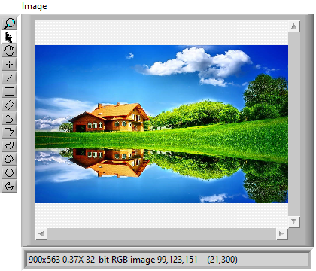
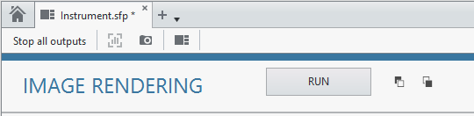
POC on Image transfer to InstrumentStudio
Unpack Configuration
Load Image from disk
gRPC
Convert Image to gRPC supported type
Trigger from IS
Pack the result
Convert back to Image
LabVIEW Measurement
Visualize in IS

Slide 3
Time Taken

